Slide 1


Conjugate Priors
THIS WEEK: Finish MODULE 1
and MODULE 2
6040 Bayesian Machine Learning
Prof. Bill Basener

Slide 2

Announcement: Deleted all quizzes in Modules 1 and 2.
Chapter 1

Slide 3
Topics:
Priors
Additional Material:
Oxford Bayesian Statistics Videos,
Towards Data Science,
Wikipedia
Bayes Thm (example and review)
General idea of computing priors
Example – Beta Binomial
Homework 1
Python Code
Chapter 1

Slide 4
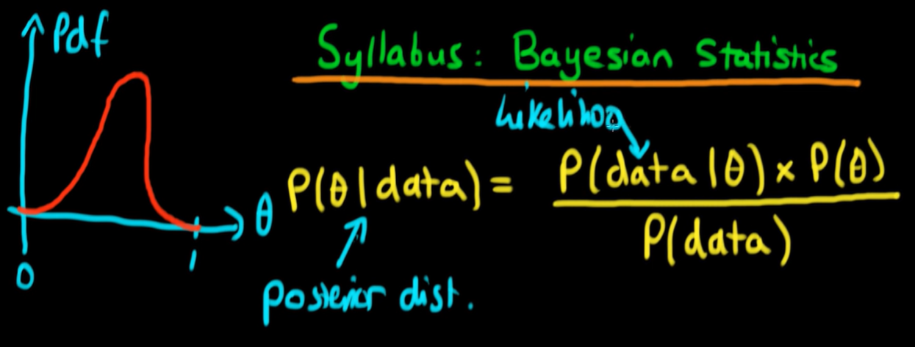
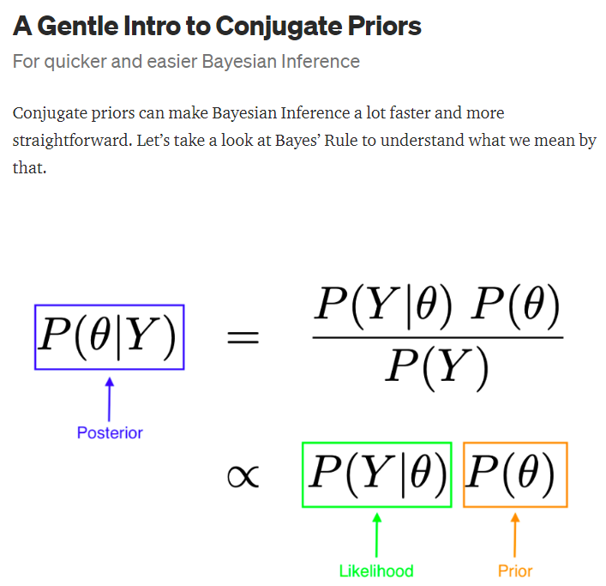
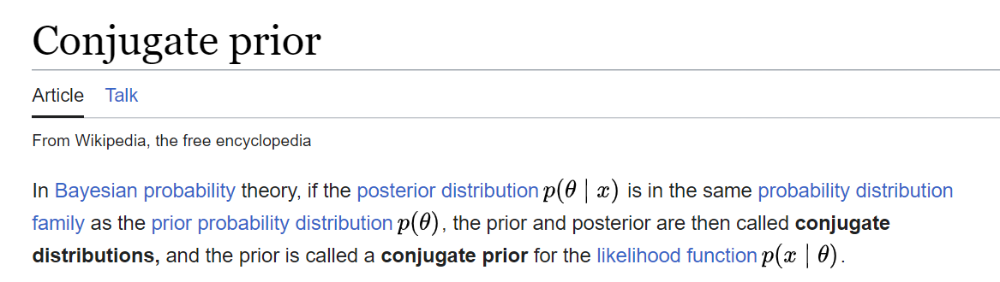
Additional Material:
Oxford Bayesian Statistics Videos,
Towards Data Science,
Wikipedia
https://www.youtube.com/watch?v=U1HbB0ATZ_A&list=PLFDbGp5YzjqXQ4oE4w9GVWdiokWB9gEpm&index=1
https://towardsdatascience.com/conjugate-prior-explained-75957dc80bfb?gi=36a667715788
https://towardsdatascience.com/a-gentle-intro-to-conjugate-priors-8be6ac0d31f6
https://en.wikipedia.org/wiki/Conjugate_prior
Chapter 1

Slide 5
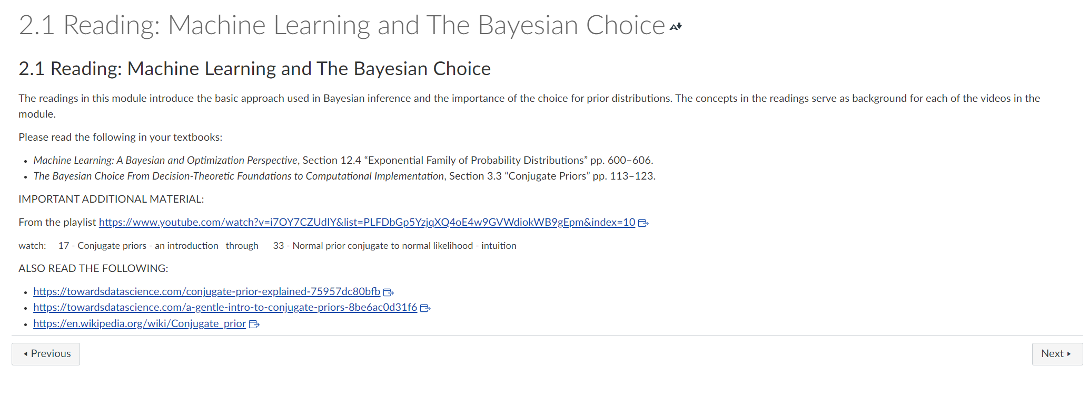
Additional Material:
Oxford Bayesian Statistics Videos,
Towards Data Science,
Wikipedia
Additional Material

Slide 6
Bayes Theorem:

Slide 7
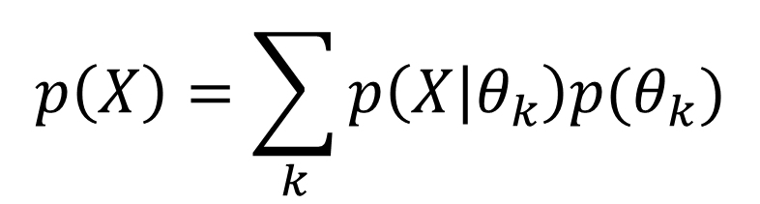
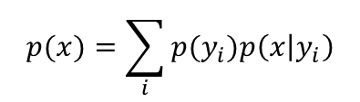


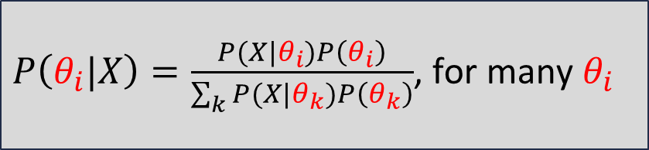
Conditioning (discrete parameter)
Proof from last week:
Dfn of Marginal Probability:
$$p(x)=\sum_{i}{p(x,y_{i})}$$
Dfn of Conditional Probability:
$p(x|y_{i})=\frac{p\left(x,y_{i}\right)}{p(y_{i})} \underset{⇒}{}$ $p\left(x,y_{i}\right)=p(y_{i})p\left(x | y_{i}\right)$
$$p(x)=\sum_{i}{p(y_{i})p\left(x | y_{i}\right)}$$
“Conditioning” is computing the denominator like this:
$$p\left(X\right)=\sum_{k}{p\left(X | θ_{k}\right)p(θ_{k})}$$
$P\left(θ_{i}|X\right)=\frac{P(X|θ_{i})P\left(θ_{i}\right)}{\sum_{k}{P(X|θ_{k})P\left(θ_{k}\right)}}$, for many $θ_{i}$
Which simply normalizes the posterior probabilities to sum to 1.
*From Video 1.13 on “Expectation and Conditioning”
General idea of computing priors

Slide 8
p = probability of heads. After a 50 flips with 21 heads, what is p?

Slide 9
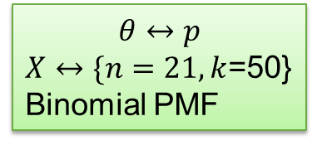
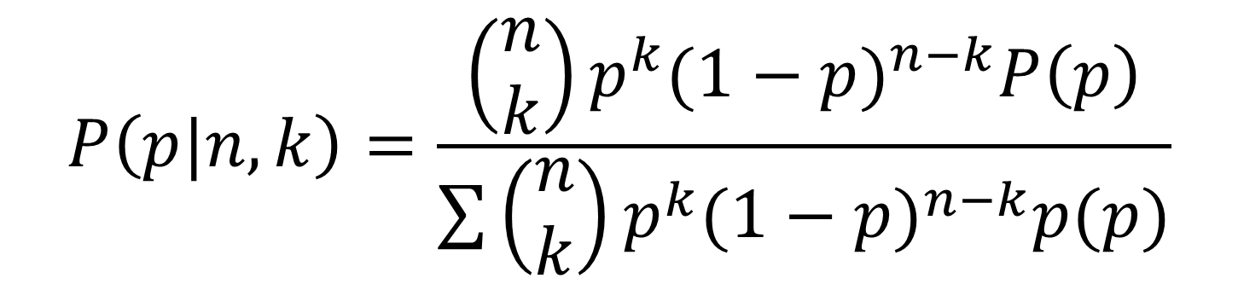
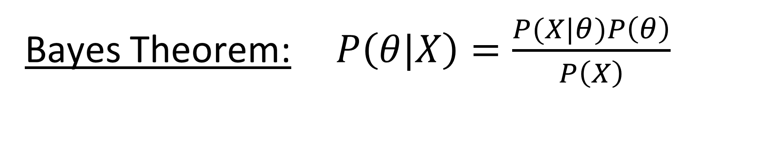
Bayes Theorem: $P\left(θ|X\right)=\frac{P(X|θ)P\left(θ\right)}{P\left(X\right)}$
$$θ↔p$$
$X↔\{n=21,k$=50}
Binomial PMF
Likelihood = Binomial PMF: $f\left(k|n,p\right)=\left(\begin{matrix}n \\ k\end{matrix}\right)p^{k}{(1−p)}^{n−k}$
$$P\left(p|n,k\right)=\frac{\left(\begin{matrix}n \\ k\end{matrix}\right)p^{k}{(1−p)}^{n−k}P\left(p\right)}{\sum{\left(\begin{matrix}n \\ k\end{matrix}\right)p^{k}{(1−p)}^{n−k}p(p)}}$$
Chapter 1

Slide 10

Python Notebook:
https://www.kaggle.com/billbasener/pt2-probabilities-likelihoods-and-bayes-theorem

Slide 11
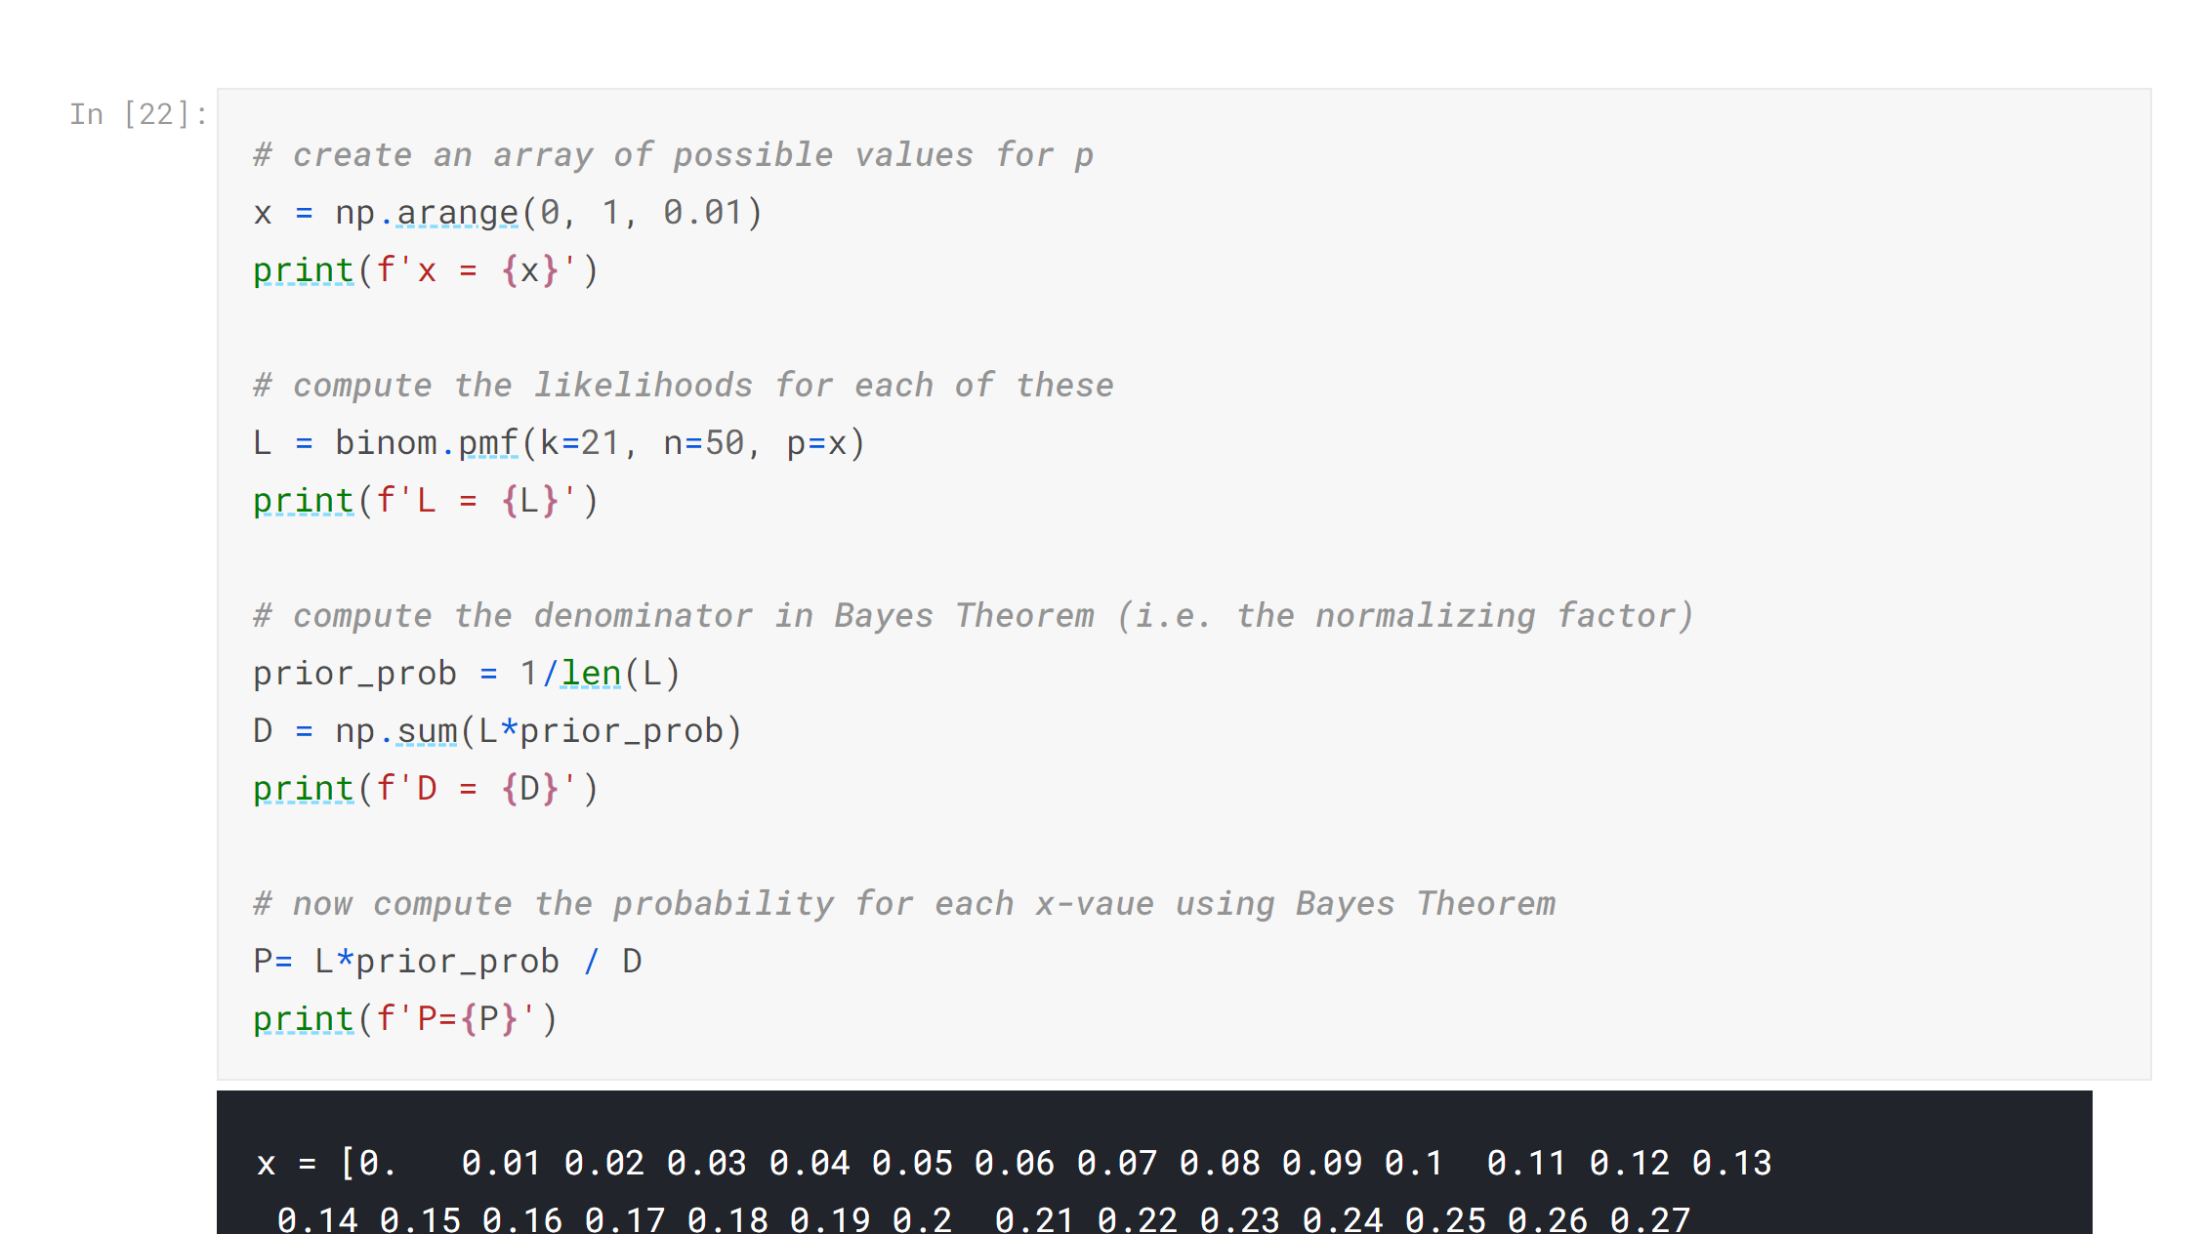
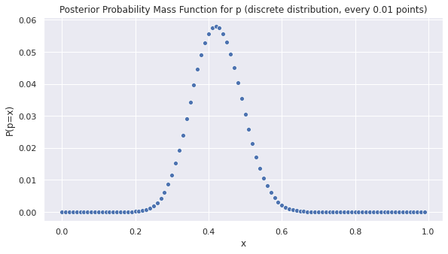
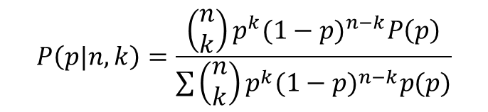
Bayes Theorem: $P\left(θ|X\right)=\frac{P(X|θ)P\left(θ\right)}{P\left(X\right)}$
$$θ↔p$$
$X↔\{n=21,k$=50}
Binomial PMF
Sum of heights is one
$$P\left(p|n,k\right)=\frac{\left(\begin{matrix}n \\ k\end{matrix}\right)p^{k}{(1−p)}^{n−k}P\left(p\right)}{\sum{\left(\begin{matrix}n \\ k\end{matrix}\right)p^{k}{(1−p)}^{n−k}p(p)}}$$
Chapter 1

Slide 12
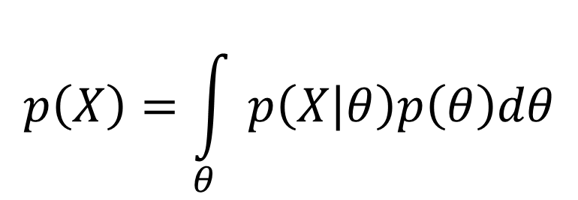
Conditioning (continuous parameter)
“Conditioning” is computing the denominator like this:
$$p\left(X\right)=\int_{θ}{p\left(X | θ\right)p\left(θ\right)dθ}$$
Which simply normalizes the posterior probabilities to integrate to 1.
*From Video 1.13 on “Expectation and Conditioning”
General idea of computing priors

Slide 13
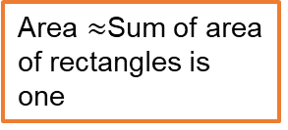
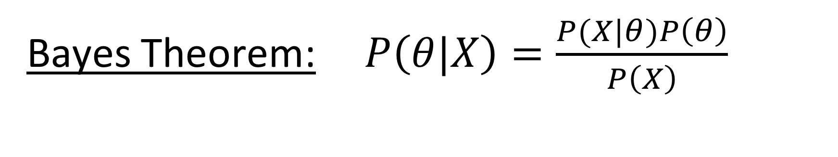
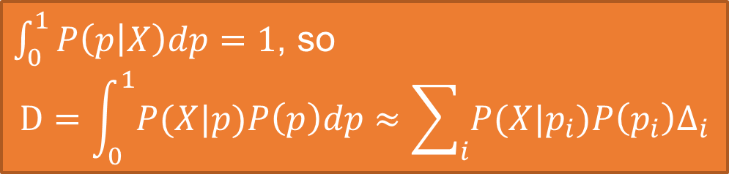
Bayes Theorem: $P\left(θ|X\right)=\frac{P(X|θ)P\left(θ\right)}{P\left(X\right)}$
$$θ↔p$$
$X↔\{n=21,k$=50}
Binomial PMF
What do we have to change?
Area $≈$Sum of area of rectangles is one
$\int_{0}^{1}{P\left(p | X\right)dp=1}$, so
$$D=\int_{0}^{1}{P(X|p)P\left(p\right)dp}≈\sum_{i}{P(X|p_{i})P\left(p_{i}\right)∆_{i}}$$
Chapter 1

Slide 14
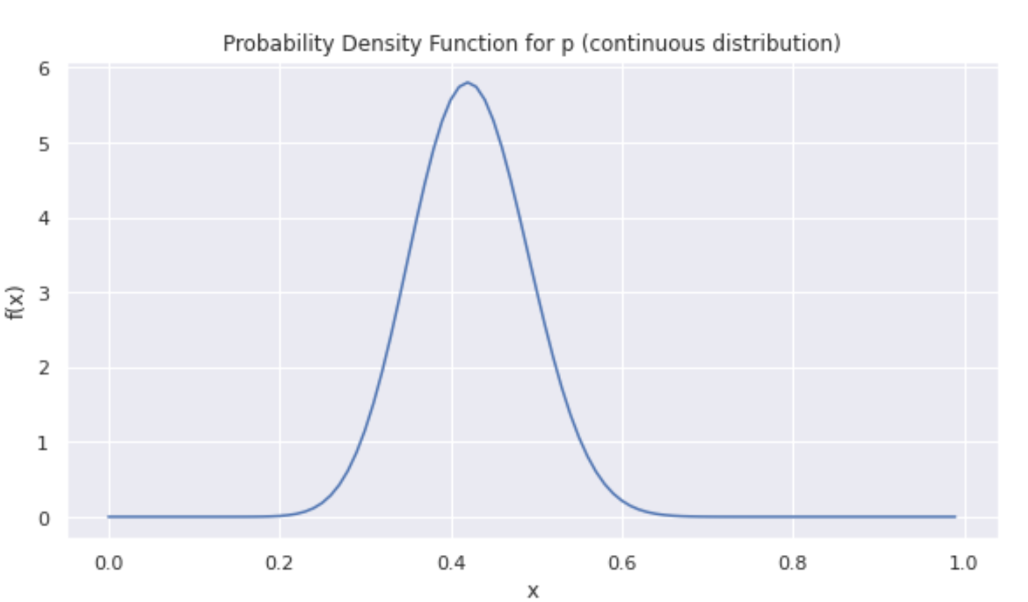
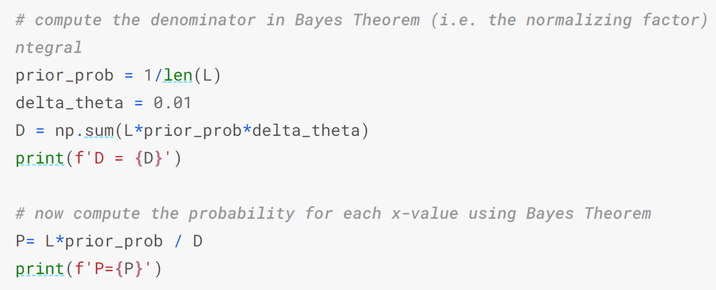

Bayes Theorem: $P\left(θ|X\right)=\frac{P(X|θ)P\left(θ\right)}{P\left(X\right)}$
$$θ↔p$$
$X↔\{n=21,k$=50}
Binomial PMF
$\int_{0}^{1}{P\left(p | X\right)dp=1}$, so
$$D=\int_{0}^{1}{P(X|p)P\left(p\right)dp}≈\sum_{i}{P(X|p_{i})P\left(p_{i}\right)∆_{i}}$$
Chapter 1

Slide 15
Priors:

Slide 16
From video lecture notes:
General idea of computing priors

Slide 17
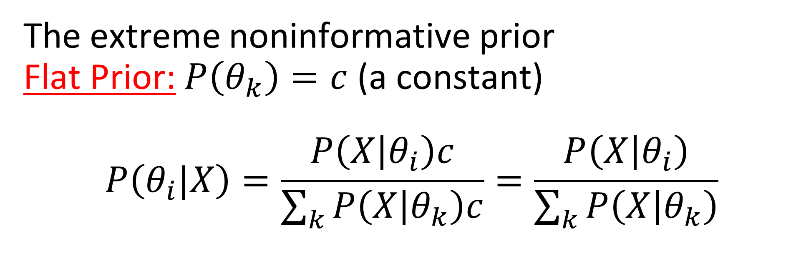
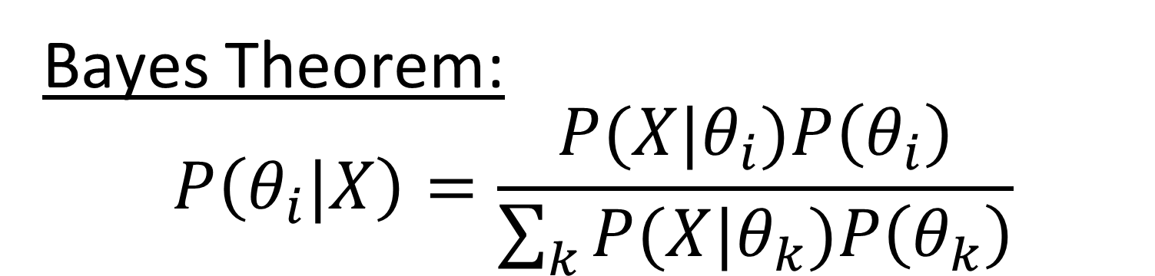
Bayes Theorem:
$$P\left(θ_{i}|X\right)=\frac{P(X|θ_{i})P\left(θ_{i}\right)}{\sum_{k}{P(X|θ_{k})P\left(θ_{k}\right)}}$$
The extreme noninformative prior
Flat Prior: $P\left(θ_{k}\right)=c$ (a constant)
$$P\left(θ_{i}|X\right)=\frac{P\left(X | θ_{i}\right)c}{\sum_{k}{P\left(X | θ_{k}\right)c}}=\frac{P\left(X | θ_{i}\right)}{\sum_{k}{P\left(X | θ_{k}\right)}}$$
Priors – Noninformative/Uninformative/Constant Prior
Chapter 1

Slide 18
Bayes Theorem:
$$P\left(θ_{i}|X\right)=\frac{P(X|θ_{i})P\left(θ_{i}\right)}{\sum_{k}{P(X|θ_{k})P\left(θ_{k}\right)}}$$
The extreme noninformative prior
Flat Prior: $P\left(θ_{k}\right)=c$ (a constant)
$$P\left(θ_{i}|X\right)=\frac{P\left(X | θ_{i}\right)c}{\sum_{k}{P\left(X | θ_{k}\right)c}}=\frac{P\left(X | θ_{i}\right)}{\sum_{k}{P\left(X | θ_{k}\right)}}$$
Priors – Noninformative/Uninformative/Constant Prior
Chapter 1

Slide 19

Bayes Theorem:
$$P\left(θ_{i}|X\right)=\frac{P(X|θ_{i})P\left(θ_{i}\right)}{\sum_{k}{P(X|θ_{k})P\left(θ_{k}\right)}}$$
The extreme noninformative prior
Flat Prior: $P\left(θ_{k}\right)=c$ (a constant)
$$P\left(θ_{i}|X\right)=\frac{P\left(X | θ_{i}\right)c}{\sum_{k}{P\left(X | θ_{k}\right)c}}=\frac{P\left(X | θ_{i}\right)}{\sum_{k}{P\left(X | θ_{k}\right)}}$$
Priors
Priors – Noninformative/Uninformative/Constant Prior
Chapter 1

Slide 20
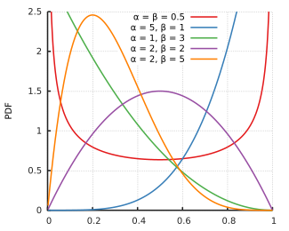
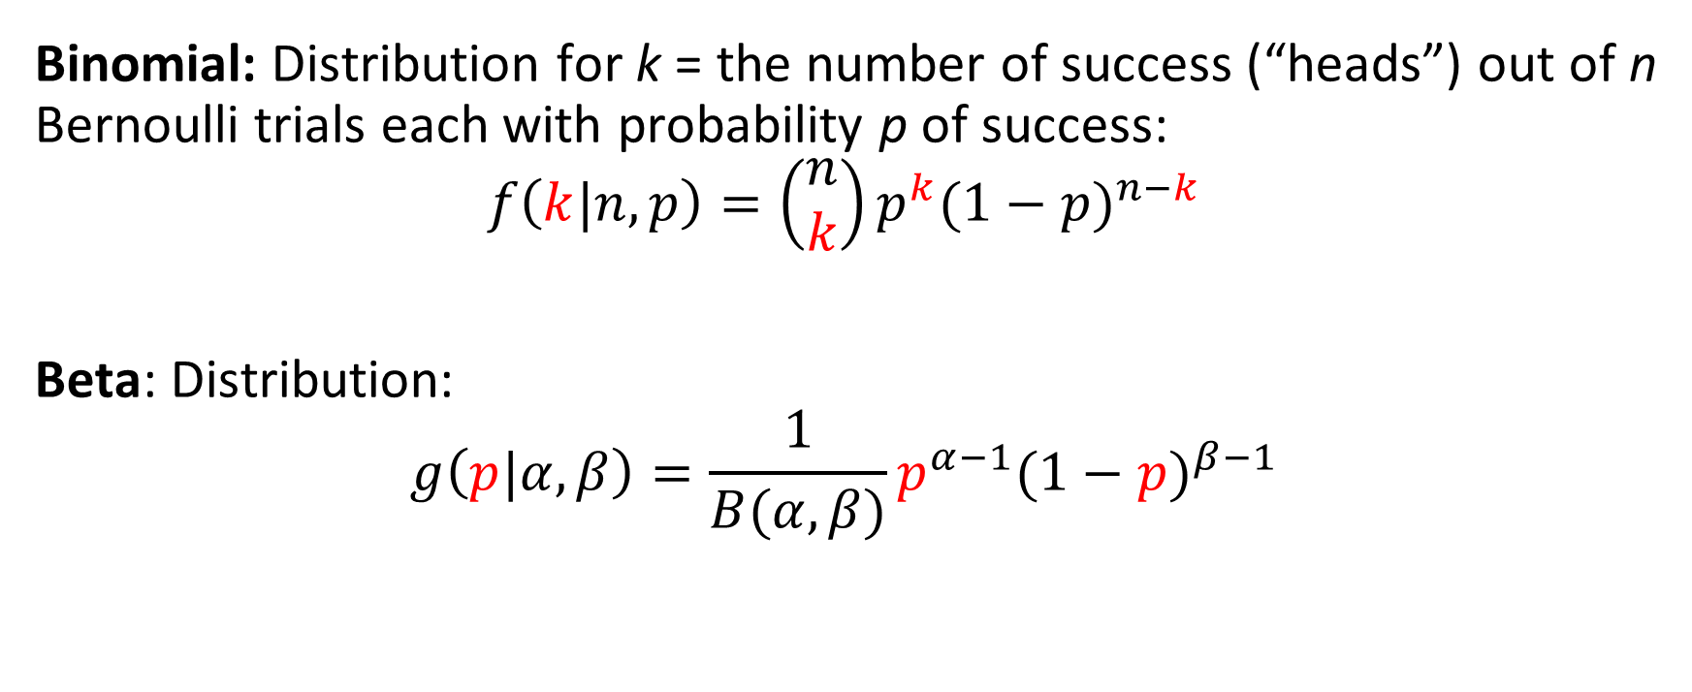

Binomial and Beta Distributions
Binomial: Distribution for k = the number of success (“heads”) out of n Bernoulli trials each with probability p of success:
$$f\left(k|n,p\right)=\left(\begin{matrix}n \\ k\end{matrix}\right)p^{k}{(1−p)}^{n−k}$$
Beta: Distribution:
$$g\left(p|α,β\right)=\frac{1}{B(α,β)}p^{α−1}{(1−p)}^{β−1}$$
NOTE: $E\left[p\right]=\frac{α}{α+β}$
Priors – Beta Binomial

Slide 21
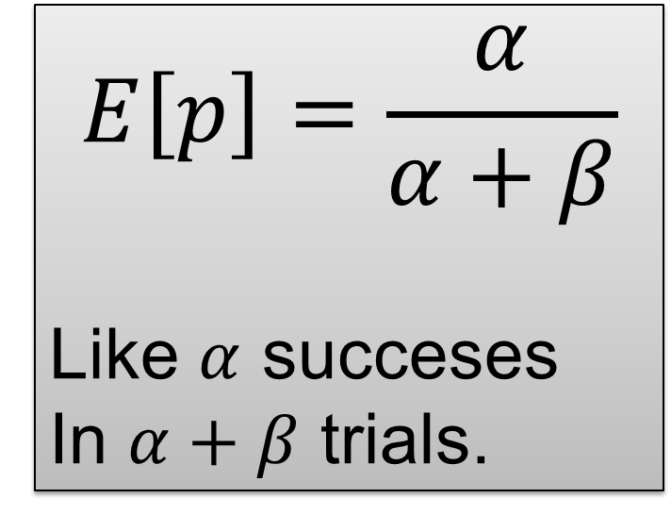
$$E\left[p\right]=\frac{α}{α+β}$$
Like $α$ succeses
In $α+β$ trials.
Priors – Beta Binomial

Slide 22
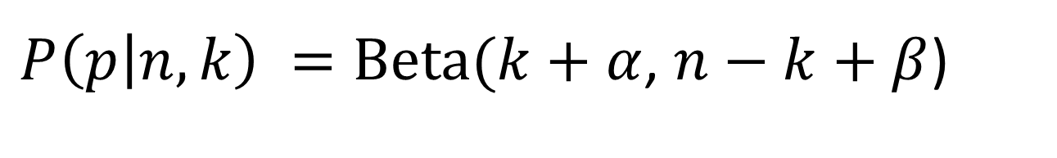

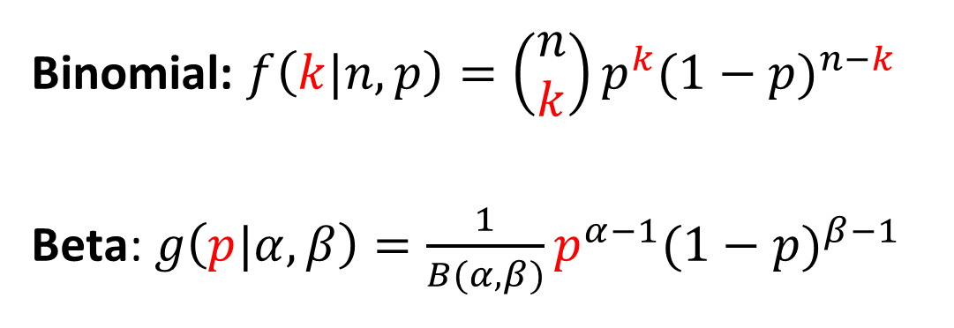
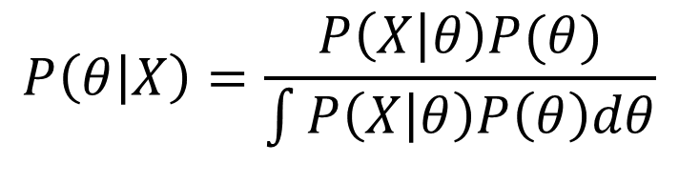
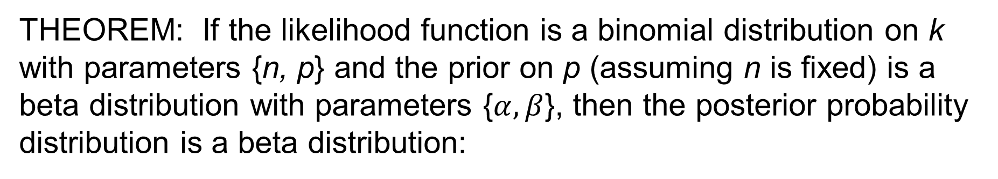
Binomial and Beta Distributions
Binomial: $f\left(k|n,p\right)=\left(\begin{matrix}n \\ k\end{matrix}\right)p^{k}{(1−p)}^{n−k}$
Beta: $g\left(p|α,β\right)=\frac{1}{B(α,β)}p^{α−1}{(1−p)}^{β−1}$
$$P\left(θ | X\right)=\frac{P\left(X | θ\right)P(θ)}{\int{P\left(X | θ\right)P\left(θ\right)dθ}}$$
$$\int_{0}^{1}{p^{α−1}{(1−p)}^{β−1}}dp$$
THEOREM: If the likelihood function is a binomial distribution on k with parameters {n, p} and the prior on p (assuming n is fixed) is a beta distribution with parameters {$α,β$}, then the posterior probability distribution is a beta distribution:
$P\left(p | n,k\right) =\text{Beta}(k+α$, $n−k+β$)
Priors – Beta Binomial

Slide 23
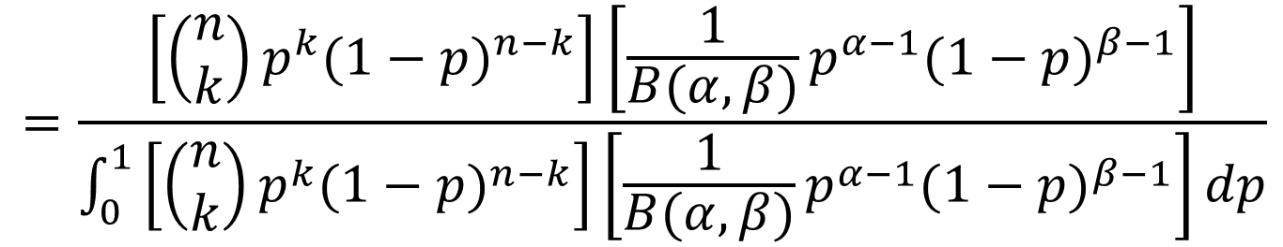
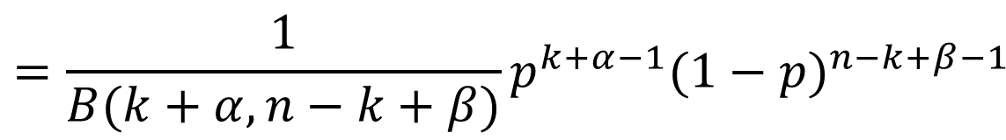
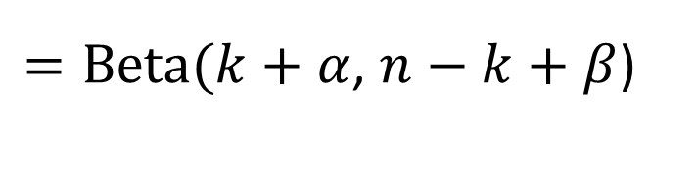

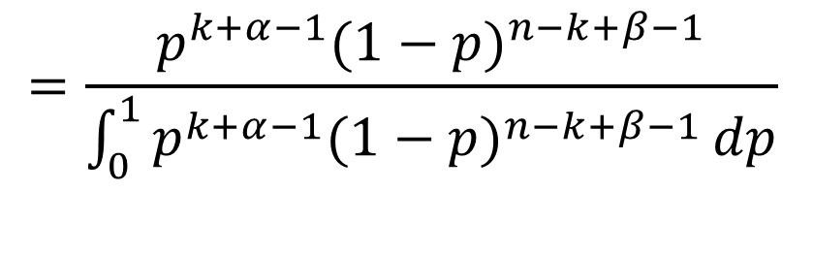
Binomial and Beta Distributions
Binomial: $f\left(k|n,p\right)=\left(\begin{matrix}n \\ k\end{matrix}\right)p^{k}{(1−p)}^{n−k}$
Beta: $g\left(p|α,β\right)=\frac{1}{B(α,β)}p^{α−1}{(1−p)}^{β−1}$
$$P\left(θ | X\right)=\frac{P\left(X | θ\right)P(θ)}{\int{P\left(X | θ\right)P\left(θ\right)dθ}}$$
$$\int_{0}^{1}{p^{α−1}{(1−p)}^{β−1}}dp$$
$$=\frac{\left[\left(\begin{matrix}n \\ k\end{matrix}\right)p^{k}{(1−p)}^{n−k}\right]\left[\frac{1}{B(α,β)}p^{α−1}{(1−p)}^{β−1}\right]}{\int_{0}^{1}{\left[\left(\begin{matrix}n \\ k\end{matrix}\right)p^{k}{(1−p)}^{n−k}\right]\left[\frac{1}{B(α,β)}p^{α−1}{(1−p)}^{β−1}\right]}dp}$$
$$=\frac{p^{k+α−1}{(1−p)}^{n−k+β−1}}{\int_{0}^{1}{p^{k+α−1}{(1−p)}^{n−k+β−1}}dp}$$
$$=\frac{1}{B(k+α,n−k+β)}p^{k+α−1}{(1−p)}^{n−k+β−1}$$
$=\text{Beta}(k+α$, $n−k+β$)
Priors – Beta Binomial

Slide 24
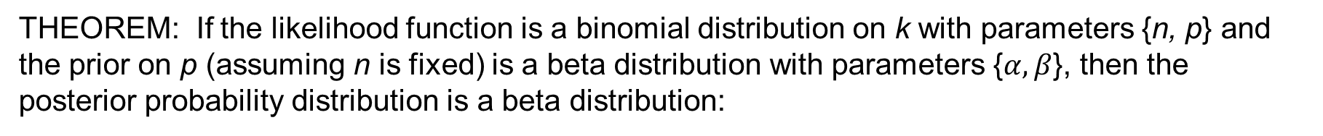
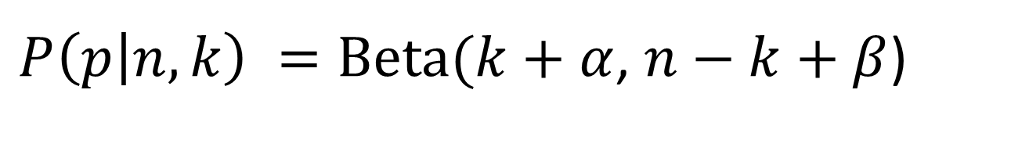
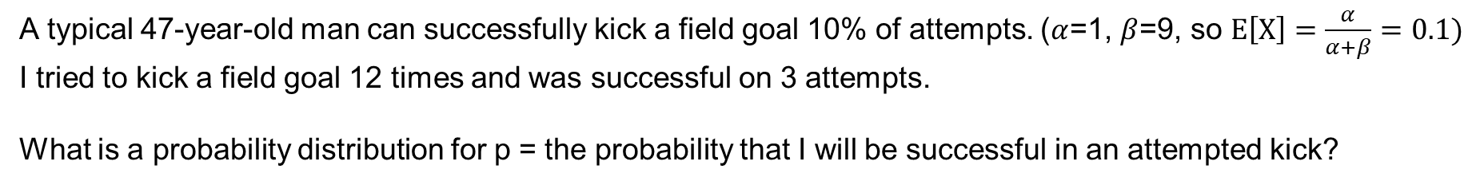
THEOREM: If the likelihood function is a binomial distribution on k with parameters {n, p} and the prior on p (assuming n is fixed) is a beta distribution with parameters {$α,β$}, then the posterior probability distribution is a beta distribution:
$P\left(p | n,k\right) =\text{Beta}(k+α$, $n−k+β$)
A typical 47-year-old man can successfully kick a field goal 10% of attempts. ($α$=1, $β$=9, so $E\left[X\right]=\frac{α}{α+β}=0.1)$
I tried to kick a field goal 12 times and was successful on 3 attempts.
What is a probability distribution for p = the probability that I will be successful in an attempted kick?
Priors – Beta Binomial

Slide 25
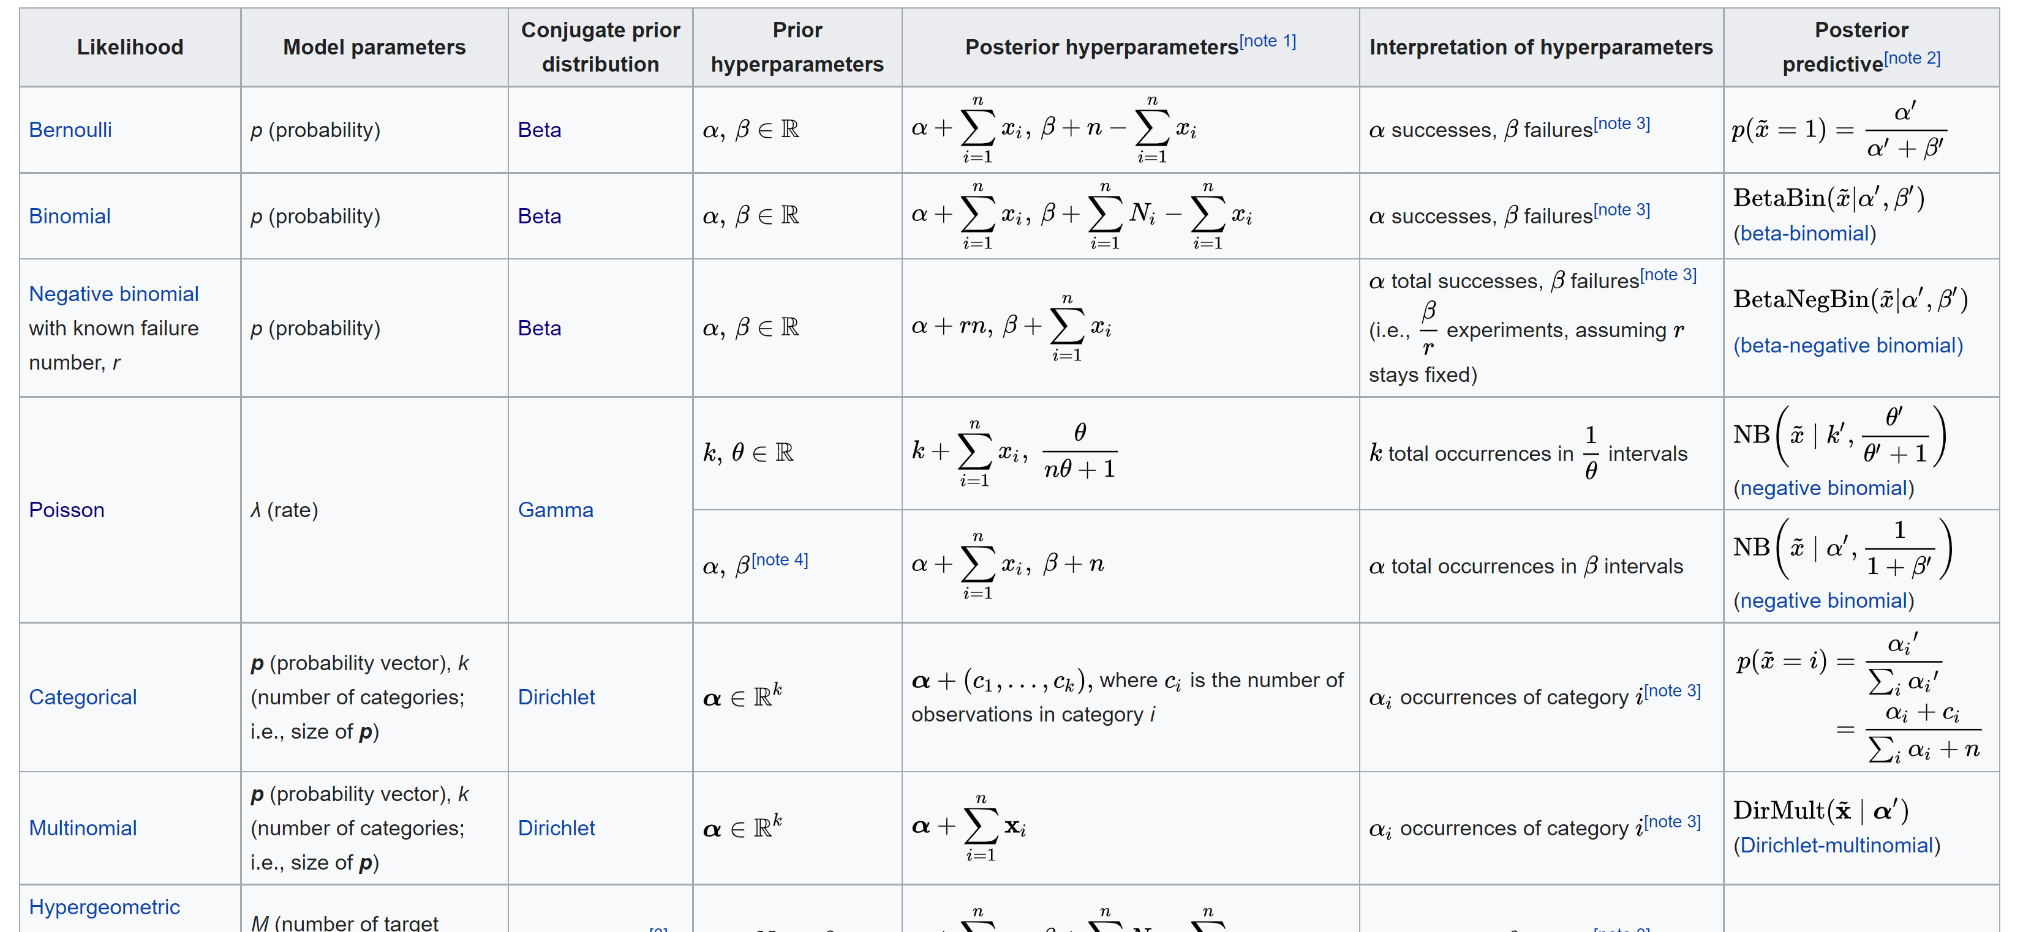
https://en.wikipedia.org/wiki/Conjugate_prior
Wikipedia

Slide 26
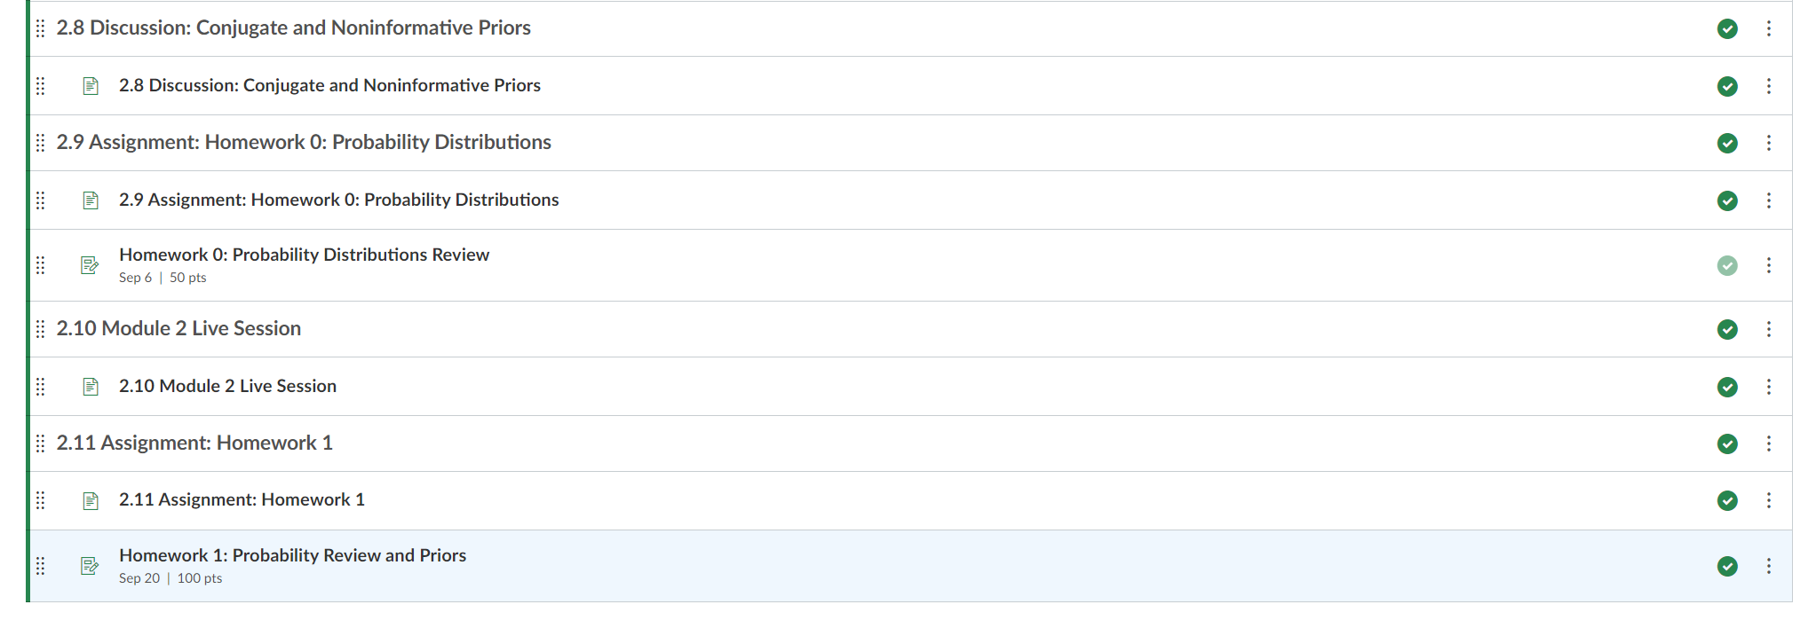
Homework 1

Slide 27
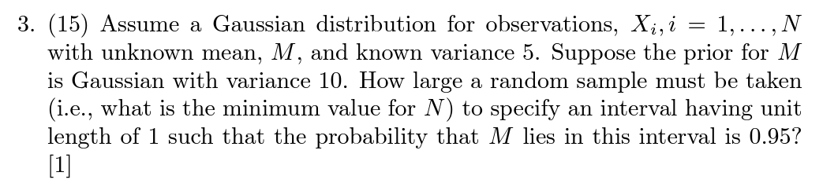
Homework 1

Slide 28
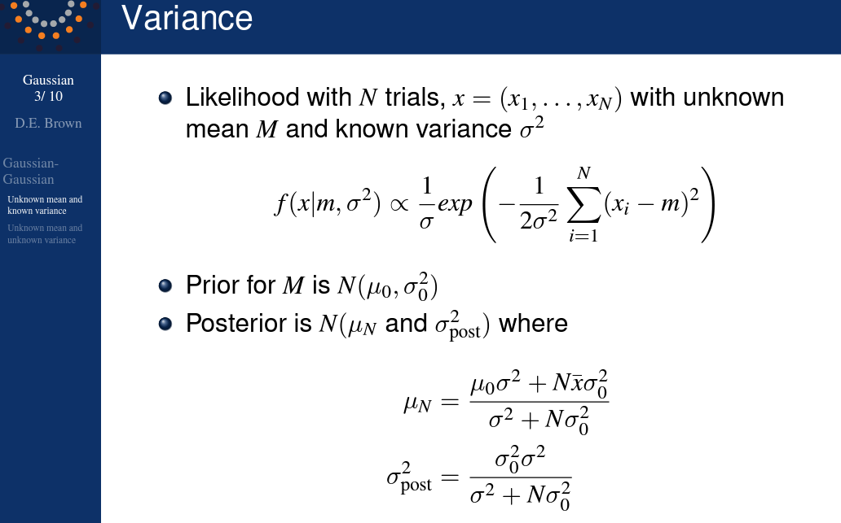
Homework 1

Slide 29
HW # 1 Notes
1. Walk through what might happen:
A-C
A-B-C
C
etc.
2. Markov chains are in Module 3. To shown this is a Markov chain, list the possible states and produce a transition matrix.
3. Use the info and formulas from Dr. Brown's Lectures on conjugate priors. We are using here a benefit of conjugate priors, that you get a formula for the posterior.
4 and 5 - the needed data files are in the "Resources" tab on Collab. Do the work in a Python notebook and submit.
Homework 1

Slide 30
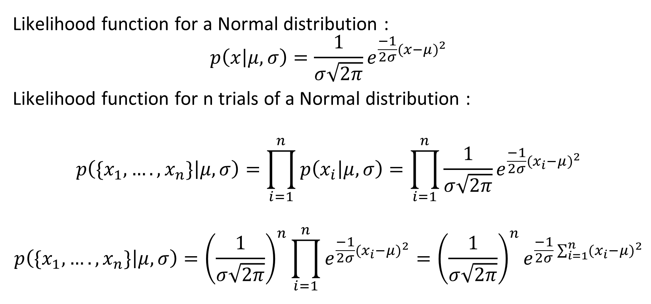
Likelihood for n Trials from Normal Distribution:
Likelihood function for a Normal distribution :
$$p\left(x | μ,σ\right)=\frac{1}{σ\sqrt{2π}}e^{\frac{−1}{2σ}{(x−μ)}^{2}}$$
Likelihood function for n trials of a Normal distribution :
$$p\left(\{x_{1},….,x_{n}\} | μ,σ\right)=\prod_{i=1}^{n}{p\left(x_{i} | μ,σ\right)}=\prod_{i=1}^{n}{\frac{1}{σ\sqrt{2π}}e^{\frac{−1}{2σ}{(x_{i}−μ)}^{2}}}$$
$$p\left(\{x_{1},….,x_{n}\} | μ,σ\right)={\left(\frac{1}{σ\sqrt{2π}}\right)}^{n}\prod_{i=1}^{n}{e^{\frac{−1}{2σ}{(x_{i}−μ)}^{2}}}={\left(\frac{1}{σ\sqrt{2π}}\right)}^{n}e^{\frac{−1}{2σ}\sum_{i=1}^{n}{{(x_{i}−μ)}^{2}}}$$

